Slide 1
Cohort state-transition Modeling in R
Decision Modeling for Public Health Workshop
2021 – 2022

Slide 2
Cohort State-Transition Models
Models where proportions of a cohort occupy states at each point in time (e.g., healthy, sick, stable, progressed, dead).
Transitions allowed between states with some probability.
Transitions occur in cycles (months, years etc).
Each state associated with a value associated with a model outcome ($, utility).
Markov assumption: no “memory” within states.

Slide 3
Building a cohort State-Transition Model
Determine health states
Determine transitions
Choose cycle length
Estimate transition probabilities
Estimate state utilities and costs per cycle
Calculate
Sensitivity analyses

Slide 4
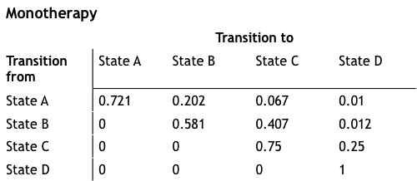
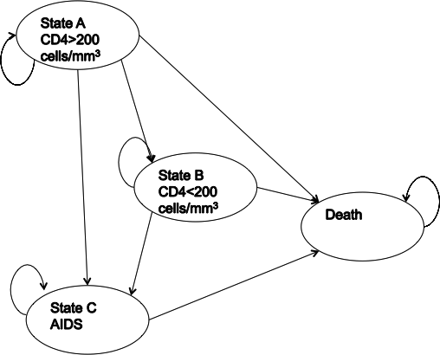
Markov Model of HIV Progression
Transition matrix
State-transition diagram
Drummond, Michael F. Methods for the economic evaluation of health care programmes. Oxford university press, 2005.

Slide 5
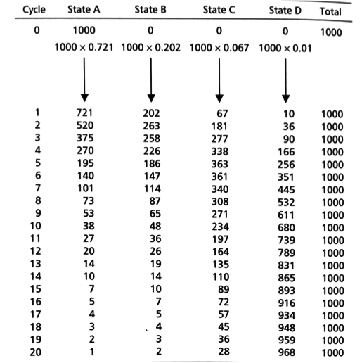
Markov
Trace
Number or distribution of individuals at each cycle

Slide 6
Three-State Model
p_HS
Healthy (H)
Sick (S)
p_HD
p_SD
Dead (D)

Slide 7
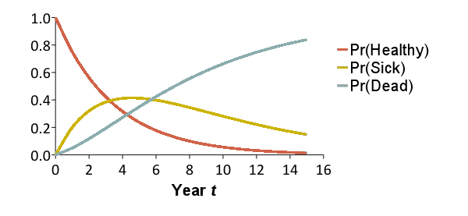
Trace the Cohort Through Time
Reflects the distribution of a cohort of patients over a set of health states over time
x₀ = [1.00 0.00 0.00]
x₁ = [0.75 0.20 0.05]
x₂ = [0.56 0.32 0.12]
x₃ = [0.42 0.38 0.19]
x₄ = [0.32 0.41 0.27]
x₅ = [0.24 0.41 0.35]
x₁₀ = [0.06 0.28 0.66]
0.20
0.15
0.75
Healthy
Sick
Dead
0.85
1.0
0.05
x_{t}(1)
x_{t}(2)
x_{t}(3)

Slide 8
Trace the Cohort Through Time
Reflects the distribution of a cohort of patients over a set of health states over time
x₀ = [1.00 0.00 0.00]
x₁ = [0.75 0.20 0.05]
x₂ = [0.56 0.32 0.12]
x₃ = [0.42 0.38 0.19]
x₄ = [0.32 0.41 0.27]
x₅ = [0.24 0.41 0.35]
x₁₀ = [0.06 0.28 0.66]
x₁₅ = [0.01 0.15 0.84]
0.20
0.15
0.75
Healthy
Sick
Dead
0.85
1.0
0.05
x_{t}(1)
x_{t}(2)
x_{t}(3)

Slide 9
Model as a Transition Matrix
Summarize transition probabilities as a matrix
Cohort distribution at next time step calculated through matrix multiplication
To:
 | Healthy | Sick | Dead
Healthy | 0.75 | 0.20 | 0.05
Sick | 0 | 0.85 | 0.15
Dead | 0 | 0 | 1.0
From:
= A
A
x_{t+1}
=
x_{t}

Slide 10
“Running” the Model
Summarize transition probabilities as a matrix
Cohort distribution at next time step calculated through matrix multiplication
To:
 | Healthy | Sick | Dead
Healthy | 0.75 | 0.20 | 0.05
Sick | 0 | 0.85 | 0.15
Dead | 0 | 0 | 1.0
From:
= A
A
0.75
0.20
0.05
x_{t+1}
=
x_{t}
0
0.85
0.15
0
0
1.0

Slide 11
“Running” the Model
Summarize transition probabilities as a matrix
Cohort distribution at next time step calculated through matrix multiplication
To:
 | Healthy | Sick | Dead
Healthy | 0.75 | 0.20 | 0.05
Sick | 0 | 0.85 | 0.15
Dead | 0 | 0 | 1.0
From:
= A
A
x₁
x₀
0.75
0.20
0.05
0.75
0.20
0.05
=
1.0
0.0
0.0
0
0.85
0.15
0
0
1.0

Slide 12
Markov Trace (Life-Years)
Calculate expected remaining LE, QALE, costs
Multiply cohort distribution by state-specific values to calculate expected value at each time
Sum expected values over time (discount if desired)
Life-Years:
1.0
1.0
0.0
Time | Healthy | Sick | Dead | E[LYs]
0 | 1.0 | 0.0 | 0.0 | --
1 | 0.75 | 0.20 | 0.05 | 0.95
2 | 0.56 | 0.32 | 0.12 | 0.88
3 | 0.42 | 0.38 | 0.19 | 0.81
 | … | … | …
Sum
* 1/(1+r)
* 1/(1+r)²
* 1/(1+r)³
Total life years: 6.77 years
(Remaining life expectancy)

Slide 13
Markov Trace (Costs)
Calculate expected remaining LE, QALE, costs
Multiply cohort distribution by state-specific values to calculate expected value at each time
Sum expected values over time (discount if desired)
Costs:
$500
$2,500
$0
Time | Healthy | Sick | Dead | E[Costs]
0 | 1.0 | 0.0 | 0.0 | --
1 | 0.75 | 0.20 | 0.05 | $875
2 | 0.56 | 0.32 | 0.12 | $1,081
3 | 0.42 | 0.38 | 0.19 | $1,1,72
 | … | … | …
Sum
* 1/(1+r)
* 1/(1+r)²
* 1/(1+r)³
Total costs: $11,557
(Total remaining lifetime costs)

Slide 14
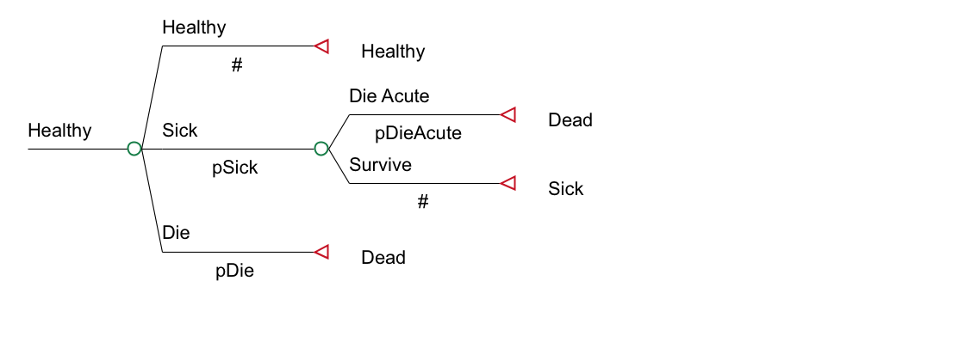
Transition Probabilities
Pr(Healthy → Dead) may not be conceptualized as one number
p_HD = p_Die + p_Sick * p_DieAcute

Slide 15
Conceptualizing the Markov model in R

Slide 16
Simple state transition model in R
p_HS
Healthy (H)
Sick (S)
p_HD
p_SD
Dead (D)
Notes:
Simple Markov to illustrate the use of Markov models
First letter from state and second letter to state

Slide 17
Simple state transition model
Model input:
p_{HS}: transition probability from Healthy to Sick
p_{HD}: transition probability Healthy to Dead
p_{SD}: transition probability Sick to Dead
c_{H}: cost of being in state Healthy
c_{S}: cost of being in state Sick
e_{H}: outcomes associated with state Healthy
e_{S}: outcomes associated with state Sick
No cost or disutility associated with death

Slide 18


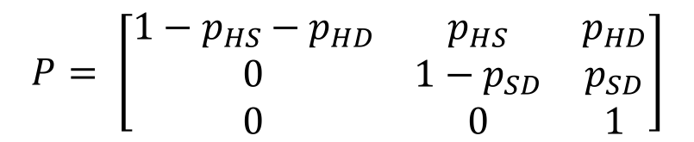
Matrix Implementation of the Markov Model
p_HS
Healthy (H)
Sick (S)
Transition probability matrix
Vector of cycle’s cost/outcomes
H S D
$$P= \left[\begin{matrix}1−p_{HS}−p_{HD} & p_{HS} & p_{HD} \\ 0 & 1−p_{SD} & p_{SD} \\ 0 & 0 & 1\end{matrix}\right]$$
H
S
D
p_HD
p_SD
Dead (D)
$$C= \left[\begin{matrix}c_{H} \\ c_{S} \\ 0\end{matrix}\right]$$
H
S
D
$$E= \left[\begin{matrix}e_{H} \\ e_{S} \\ 0\end{matrix}\right]$$
H
S
D
Notes:
Who is familiar with basic matrix calculations?
-> Inner product

Slide 19
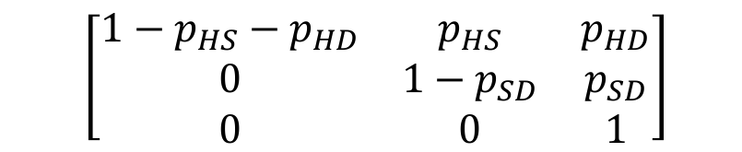

Matrix Implementation of the Markov Model
Create the t x 3 matrix M that will store the proportion of the cohort at each state and cycle:
At t = 0 :
M₀ = [1, 0, 0]
For t < T :
M_{t + 1}=M_{t} P
$$\left[\begin{matrix}1−p_{HS}−p_{HD} & p_{HS} & p_{HD} \\ 0 & 1−p_{SD} & p_{SD} \\ 0 & 0 & 1\end{matrix}\right]$$
$$\left[\begin{matrix}H_{t} & S_{t} & D_{t}\end{matrix}\right]$$

Slide 20
Calculating total costs & effects
E = M e
TE = 1_{T} E
Total effects (TE):
Total costs (TC):
C = M c
TC = 1_{T} C
1_{T} : 1 × T vector of ones
Notes:
M(tx3) e(3x1) = t * 1
(n x m) (m x p) = (n x p)

Slide 21
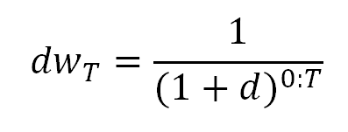
Calculating total costs & effects (discounted)
Total effects (TE):
Total costs (TC):
E = M e
TE = dw_{T} E
C = M c
TC = dw_{T} C
Notes:
M(tx3) e(3x1) = t * 1
(n x m) (m x p) = (n x p)

Slide 22
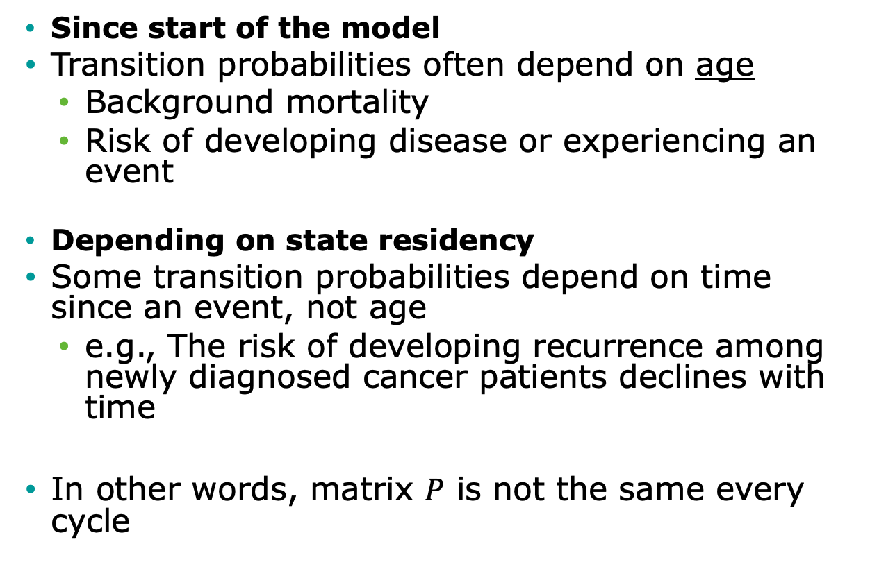
Time-dependency
Since start of the model
Transition probabilities often depend on age
Background mortality
Risk of developing disease or experiencing an event
Depending on state residency
Some transition probabilities depend on time since an event, not age
e.g., The risk of developing recurrence among newly diagnosed cancer patients declines with time
In other words, matrix $P$ is not the same every cycle

Slide 23
Time dependency since start of the model

Slide 24
Time-dependency since model start
Transition probabilities often depend on time since model start
Background mortality
Risk of developing disease or experiencing an event
In other words, matrix P is not the same every cycle
Replace matrix P with matrices P_{t}, where t is time since model start

Slide 25
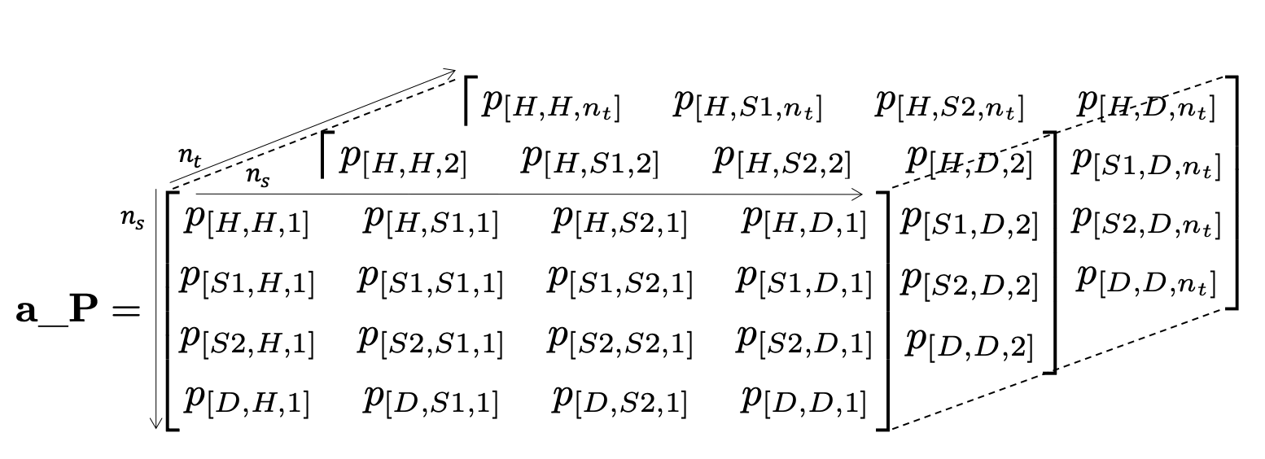
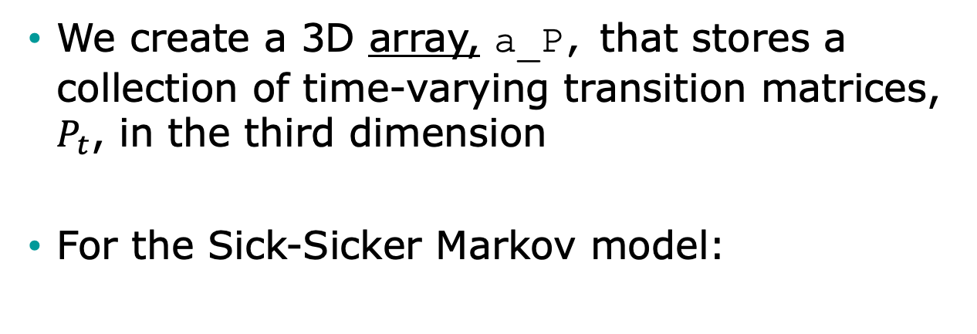
Time-varying probabilities in R
We create a 3D array, a_P, that stores a collection of time-varying transition matrices, $P_{t}$, in the third dimension
For the Sick-Sicker Markov model:

Slide 26
R Session –
3 state example

